Slide 1
Inventory Management System
ITM 201 – Final Project
Sreu Longyi

Slide 2
Table of contents
Project issue, problem to be solved
Current progress
Project Functions/Features
Database applied
Application use case

Slide 3
Project issue, problem to be solved
The project aims to solve the problem of efficiently managing inventory for a business or organization. It provides a user-friendly interface for managing products, stock levels, and sales.

Slide 4
Current Progress (PDLC)
The project is currently in the design phase. The problem analysis has been completed, and the design of the user interface and database structure is in progress.

Slide 5
Project Functions/Features
Product Management: Add, edit, and delete products.
Stock Management: Track stock levels and receive alerts for low stock.
Sales Management: Record sales and generate reports.
User Management: Manage user accounts and permissions.
Search Functionality: Search for products based on various criteria.
Reporting: Generate reports on inventory, sales, and profitability.

Slide 6
Database Applied
The project will utilize a relational database management system (RDBMS) such as MySQL or PostgreSQL. The database will consist of tables for products, stock, sales, users, and other relevant entities.

Slide 7
Application Use Cases
A retail store can use the system to manage their inventory, track stock levels, and generate sales reports.
An e-commerce business can use the system to manage their product catalog, track inventory, and process orders.
A warehouse can use the system to manage incoming and outgoing stock, track stock levels, and generate reports.

Slide 8
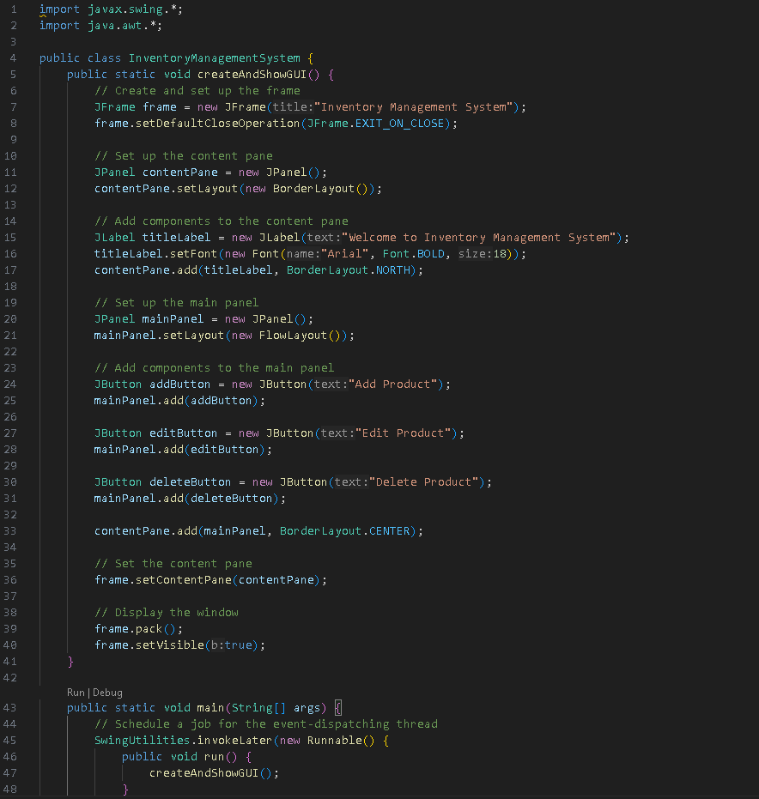
Code explanation
This is a basic example that creates a Swing-based GUI for the inventory management system. It includes a title label and three buttons for adding, editing, and deleting products. You can customize and expand upon this code to suit your specific requirements.
The code begins with import statements that import necessary classes from the javax.swing and java.awt packages. These packages provide classes and interfaces for creating GUI components and managing graphical user interfaces.
The InventoryManagementSystem class is the main class that contains the createAndShowGUI method.
The createAndShowGUI method is responsible for creating and displaying the GUI for the inventory management system.
The main method is the entry point of the program. It schedules a job for the event-dispatching thread using the SwingUtilities.invokeLater method. This ensures that the GUI is created and shown on the event-dispatching thread, which is the thread responsible for handling GUI events and updates.

Slide 9
Thank For Watching

